Slide 1

Enhancing Dense Crowd counting CNN’s.
Rebecca Azoulay Christian Shakkour

Slide 2
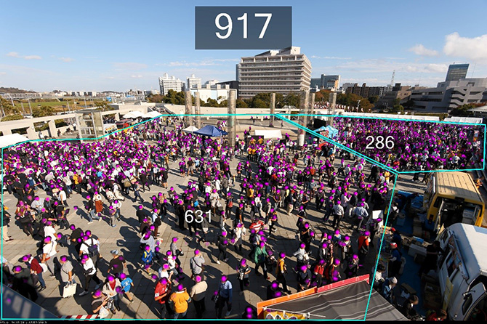
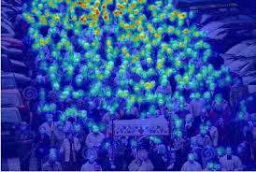
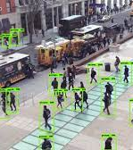
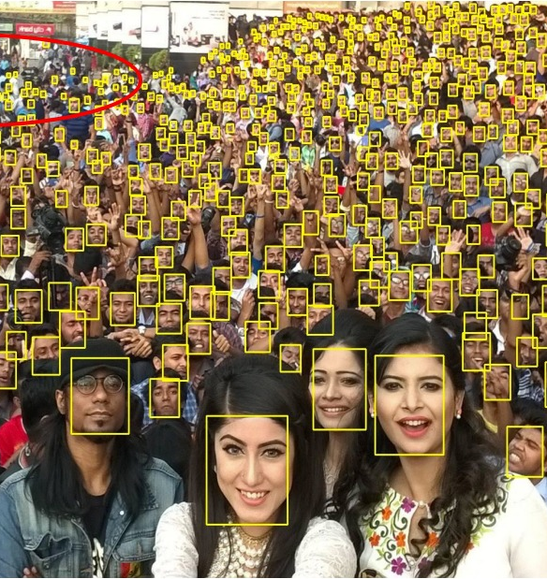
What is Crowd Counting

Slide 3
Introduction
Demand for accurate crowd counting using CNN’s
Application of Computer Vision technology
Useful in many cases : event planning, safety and security, traffic, advertising
Good methods of crowd counting can also be extended to other domains, for instance, counting cells in biology
Many algorithms have been proposed for crowd counting in videos and images.

Slide 4
Existing solutions for videos
Method | Feedback
Detection-style framework | Occlusion among people in a clustered environment or in a very dense crowd significantly affects the performance of the detector
Cluster trajectories of tracked visual features | Do not work for estimating crowds from individual still images
Feature-based regression : segmenting the foreground extracting various features from the foreground, such as area of crowd mask utilizing a regression function to estimate the crowd count | Most extensively used method
Linear or piece-wise linear functions | Relatively simple models and yield decent performance
Ridge regression (RR), Gaussian process regression (GPR), and neural network (NN) | More advanced/effective methods

Slide 5
Existing solutions for still images
Interest points (SIFT), Fourier analysis, Different Feature Extraction.
Support vector machine (SVM)
CNN methods based on the perspective and density map.

Slide 6

Limitations
Dense Crowded Images
Low Light Images.
Perspective maps not readily available in many applications.

Slide 7
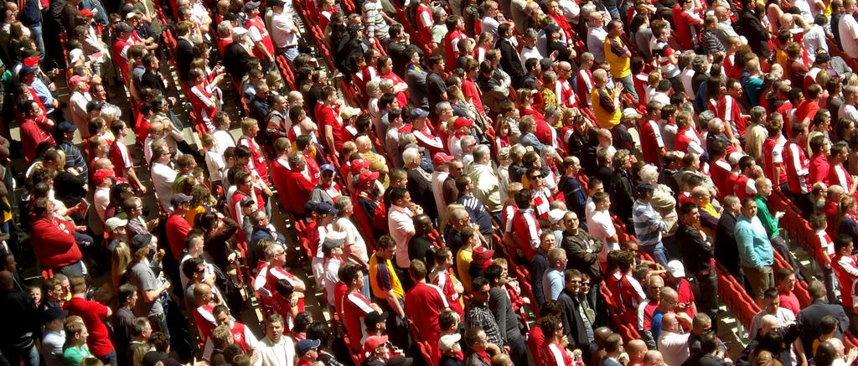
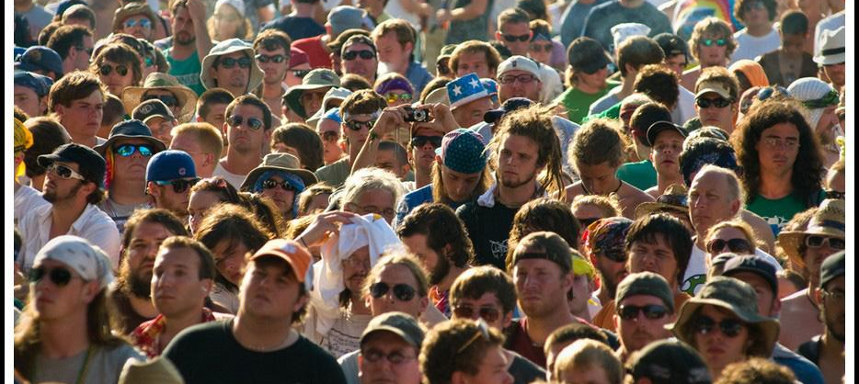
Dataset
ShanghaiTech

Slide 8
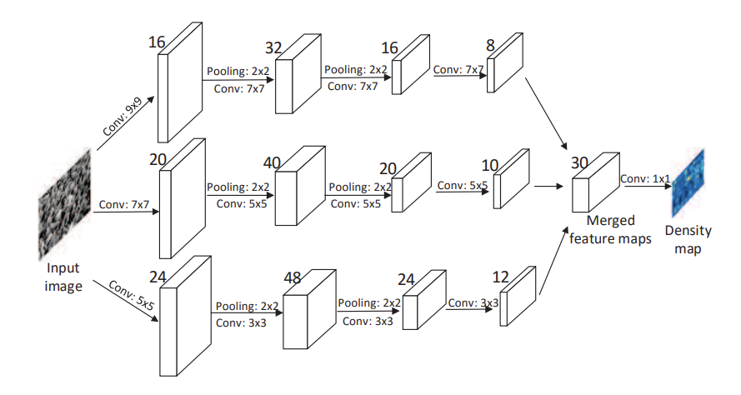
MCNN Original Solution
Advantages of transfer learning on Crowd density estimation:
Adaptive to different head sizes.
Simpler training.
Easy fine tuning.

Slide 9
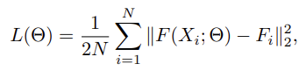
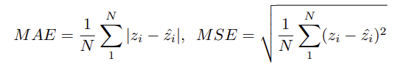
Training features
Loss function
Training
Batch based SGD
Transfer learning
N: Number of images
F(Xi,W): Estimated density map from MCNN
Fi: Given density map from dataset

Slide 10
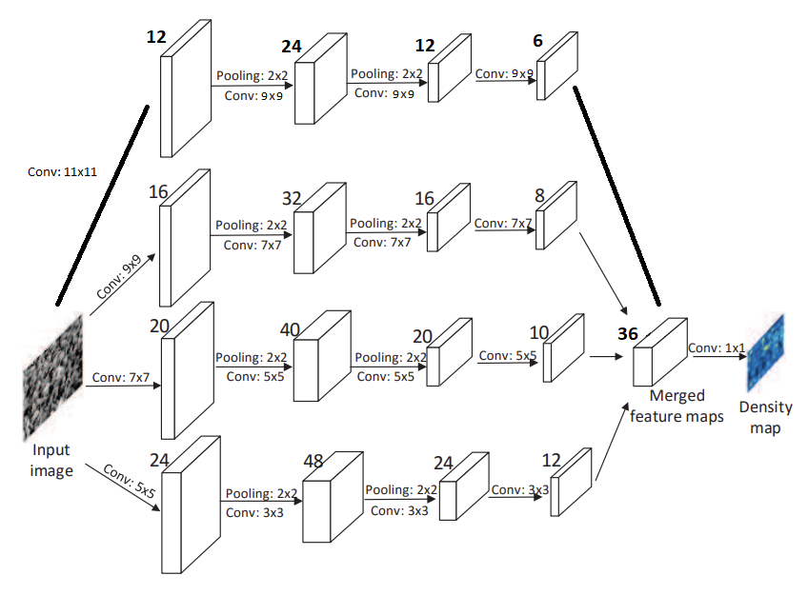
MCNN Enhanced Network
Extend a multi-column deep neural networks for image classification by adding another column.
In the original model, an arbitrary number of columns can be trained on inputs preprocessed in different ways.

Slide 11
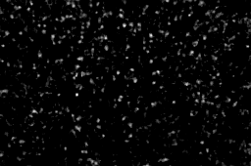
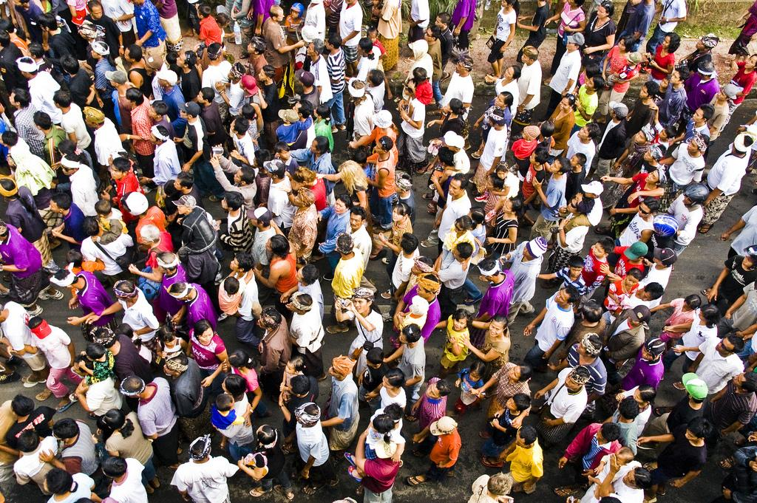
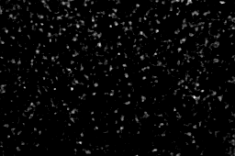
Base vs Enhanced Density map Comparison
Original model
With Enhancement

Slide 12
Models Results
Original
Best model after 298 Epochs
MAE: 112.14, MSE: 170.79
Enhanced
Best model after 298 Epochs MAE: 110.59 ,MSE: 167.66

Slide 13
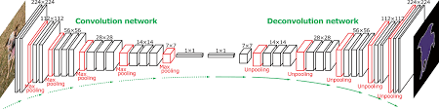
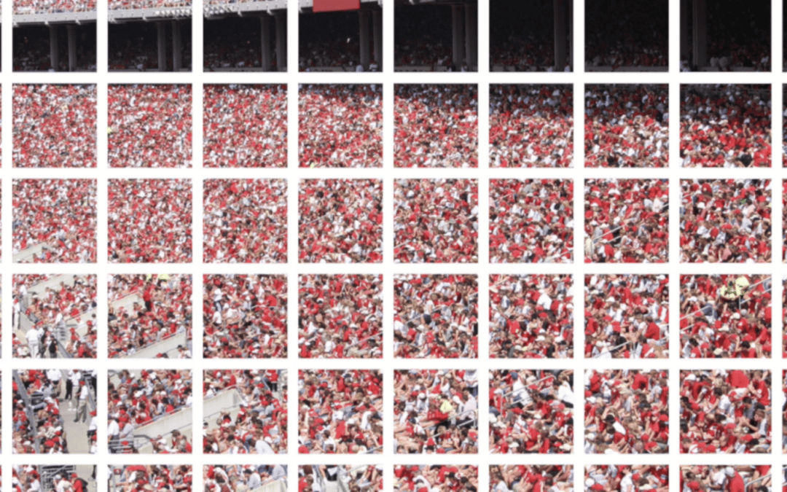
Future Work
Deconvolution layers to Enlarge the output resolution.
Tiling the images

